Slide 1
Big Data Analytics for Enhancing Retail Strategies
AIT 622 004
Dr. Hadi Rezazad
George Mason University
04/12/2024
By Team 3:
Pavan Jeevan Buddala
Sai Sriram Dubasi
Nikhil Reddy Gatla
Jagadeesh Varma Gadiraju

Slide 2
Introduction and Background
In the fiercely competitive retail sector, understanding the dynamics between pricing strategies and consumer behavior during events like Flipkart's "Big Billion Days" is essential for growth and profitability.
Our study uses big data analytics to examine the interactions between customer reviews, ratings, discounts, and pricing, with the goal of delivering actionable insights.
These insights aim to help retailers fine-tune their pricing and marketing tactics to increase market share and profit margins during key sales periods.
We apply advanced statistical and machine learning methods to offer a detailed guide for boosting retail strategy through precise, data-driven choices.

Slide 3
Problem Description
The core challenge is to establish how discount percentages impact customer reviews and ratings, and how these interactions influence product pricing during significant sales events like Flipkart's "Big Billion Days.”
Our study aims to identify the key factors driving price variations during these events, providing a clearer understanding of consumer purchase behavior.
The insights gained will guide enhancements to sales tactics and pricing strategies, ultimately optimizing profitability and market performance during peak sales periods.

Slide 4
Current Data Environment
Our dataset from Flipkart includes comprehensive information such as product names, IDs, offer prices, original prices, discount percentages, average ratings, total ratings, total reviews, product descriptions, product URLs, and data collection dates.
This extensive dataset is crucial for our study, enabling us to analyze trends and correlations over time between pricing, discounts, and customer feedback during major retail events like "Big Billion Days.”
The depth and variety of the data provide a robust foundation for deploying sophisticated statistical methods and machine learning techniques to derive actionable insights that drive strategic retail decisions

Slide 5
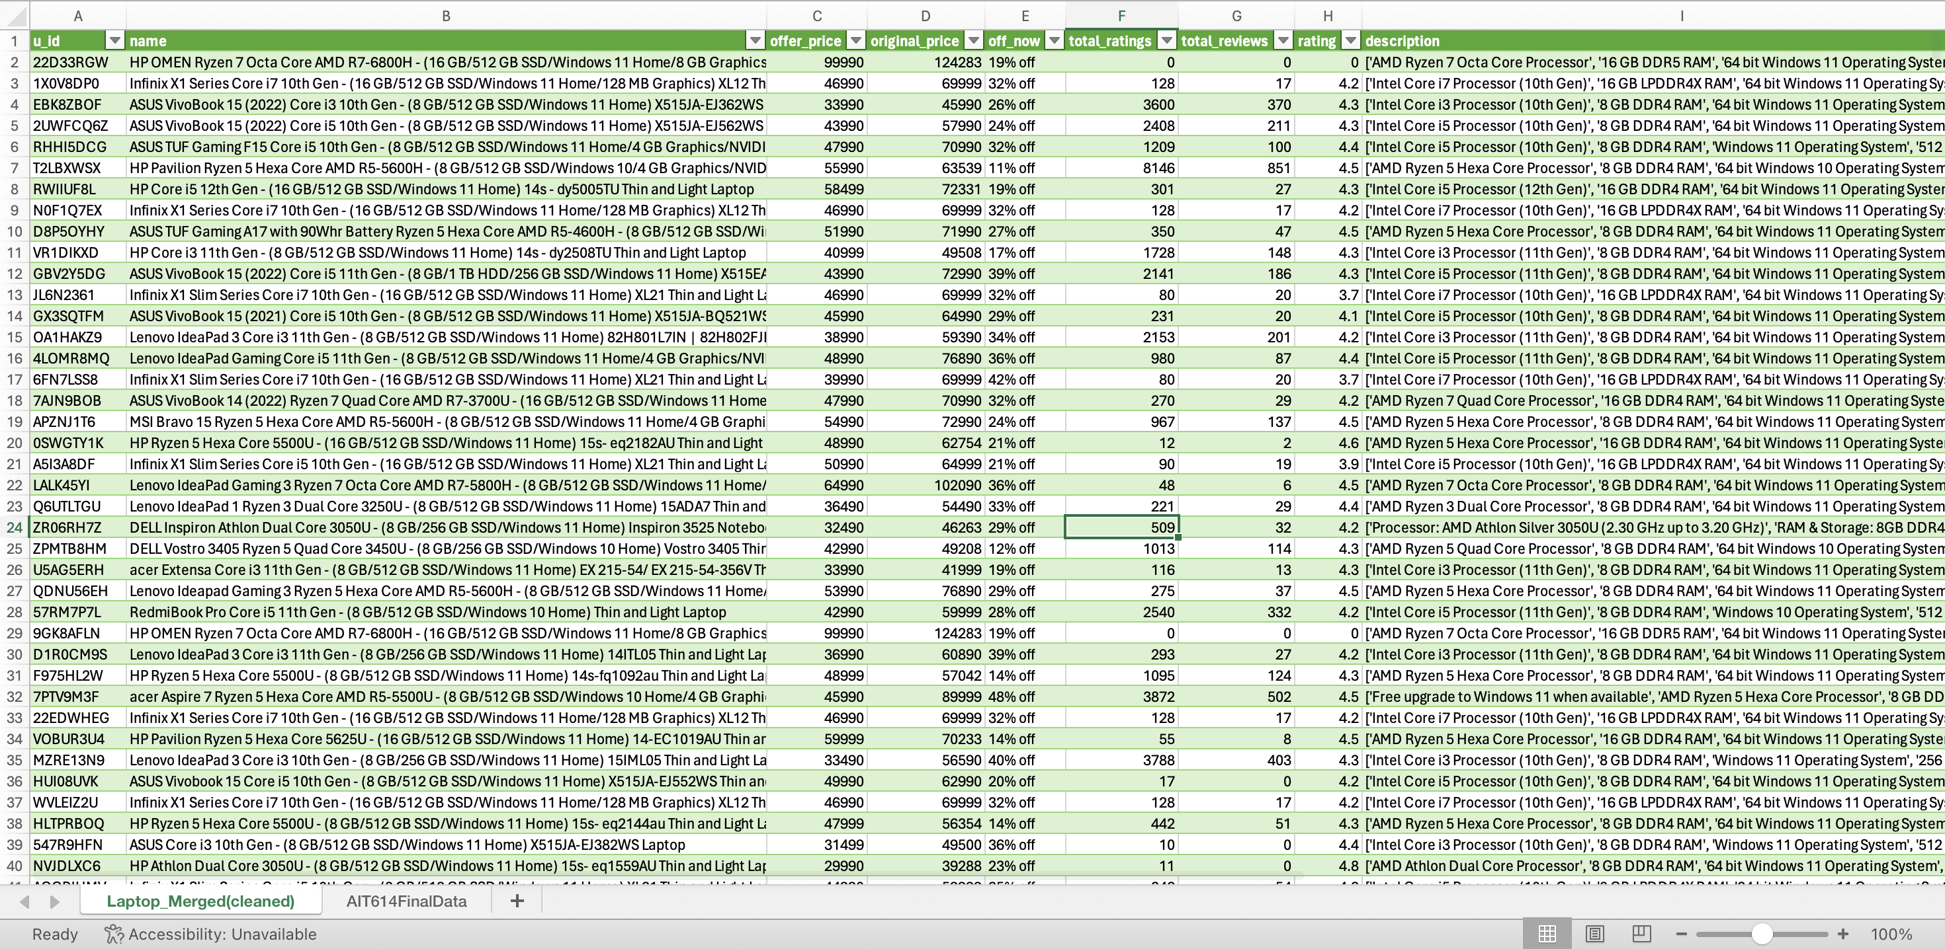
Dataset
Flipkart - Electronic items prices
Data Source: Kaggle https://www.kaggle.com/datasets/kiranbudati/mobile-prices-flipkart/data

Slide 6
Stakeholder Engagement
Primary Stakeholders: Marketing Team utilizes insights to tailor marketing strategies for significant sales events; Sales Team uses predictions to adapt sales approaches; Product Management sets pricing strategies aligned with market trends; Data Science Team develops predictive models and analyzes complex market dynamics.
Secondary Stakeholders: IT and Data Engineering Teams support the infrastructure for data analysis and ensure data security; Executive Leadership leverages research summaries for strategic decisions to boost revenues; Legal and Compliance Teams ensure data practices adhere to regulatory standards.
The project outcomes aim to enhance decision-making across departments, leading to more targeted marketing, optimized pricing strategies, and ultimately, improved profitability and competitive advantage in the market.

Slide 7
Required Resources
Data: Access to a comprehensive repository of historical sales data is crucial, including details on product IDs, names, prices, discounts, ratings, reviews, and descriptive information necessary for in-depth analysis.
Technology: The need for substantial processing power, sophisticated statistical and data analysis tools, and cloud-based storage solutions to manage and analyze large datasets efficiently.
Personnel: A dedicated team comprising analysts, data scientists, and project managers, along with potential consultants, is essential to carry out the extensive analysis and manage project workflows.
Budget: Sufficient funding is required to support the acquisition of technology, hiring of personnel, and other project-related expenses to ensure successful execution and maximize the project’s return on investment.

Slide 8
Build Vs Buy Analysis
Build Option: Leverage existing staff and infrastructure to develop data collection and analysis capabilities in-house. Pros include better control over processes and direct integration with company systems; cons involve the significant time and cost of developing expertise and technology from scratch.
Buy Option: Outsource complex modeling and predictive analytics to specialized firms. Pros include accessing advanced expertise and technology immediately; cons may include higher long-term costs and less control over data handling and analysis.
Recommendation: Adopt a hybrid approach by setting up internal capabilities for initial data handling and basic analysis while outsourcing specialized, high-complexity tasks to external experts. This strategy balances control, cost, and access to advanced analytical capabilities.

Slide 9
Project Timeline
Phase | Approx. Time
Data Collection, Cleaning, Exploratory Analysis | 03/21/24 - 03/26/24
Detailed Statistical Modelling and analysis | 03/31/24 - 04/04/24
Gathering Information and Formulating a Strategy | 04/05/24 - 04/07/24
Making a presentation to Stakeholders | 04/07/24 - 04/12/24
Multiple iterations for each major phases
Data Preparation
Exploratory Analysis
Comprehensive Statistical Analysis
Final Reporting

Slide 10
Expected Values/ Benefits
Inventory Management: Insights from the study are expected to enable more effective inventory control, helping to optimize stock levels and reduce overstock and understock situations during critical sales periods.
Targeted Marketing: Analysis of customer feedback and discount impacts will guide more personalized marketing strategies that are likely to engage customers better and increase conversion rates.
Pricing Strategies: Data-driven insights will allow for smarter pricing decisions that can adapt to market demands and competitor actions, maximizing profitability.
Overall Impact: Collectively, these improvements are anticipated to lead to higher sales volumes and enhanced customer satisfaction, thus boosting overall business performance and competitive positioning in the market.

Slide 11
Statistical Analysis
Correlation Analysis: Employed Pearson or Spearman correlation methods to evaluate the relationships between customer reviews/ratings and discount percentages, helping to identify variables that are closely linked and how they interact.
Regression Analysis: Utilized multiple regression to pinpoint factors that significantly affect product pricing, providing insights into how different elements such as ratings and discounts drive pricing strategies.
Impact on Strategy: These statistical techniques are critical in revealing hidden patterns and trends within the data, forming the basis for informed, strategic decisions that optimize sales and marketing efforts.

Slide 12
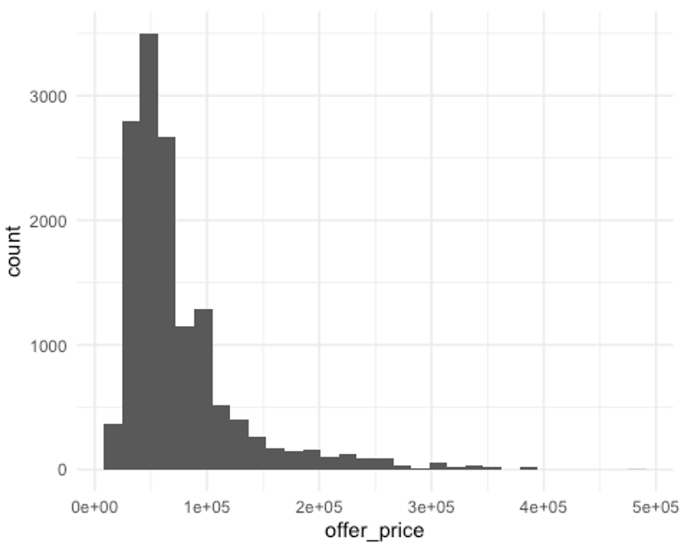
Visualizations
This histogram shows the distribution of the offer prices for laptops. The majority of laptops are priced on the lower end, with a few outliers reaching up to 481,990.

Slide 13
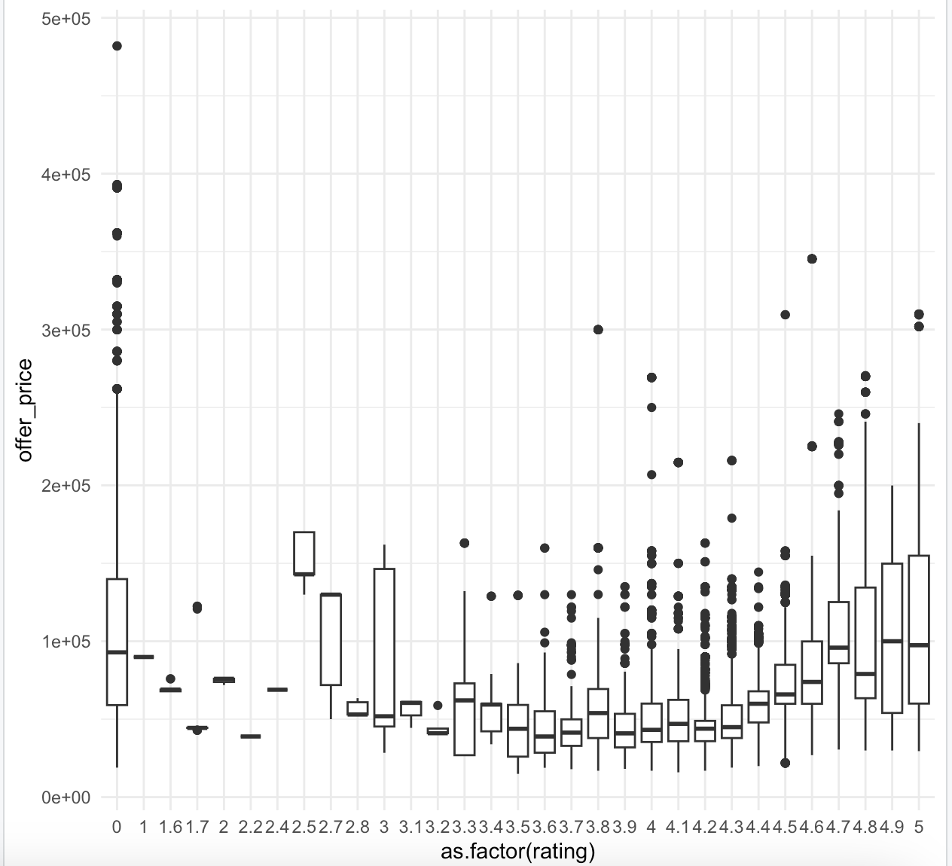
Visualizations
This box plot displays the range of offer prices for laptops across different ratings. It illustrates the variability in price for laptops with different ratings, with a general trend of increasing prices for higher-rated laptops.

Slide 14
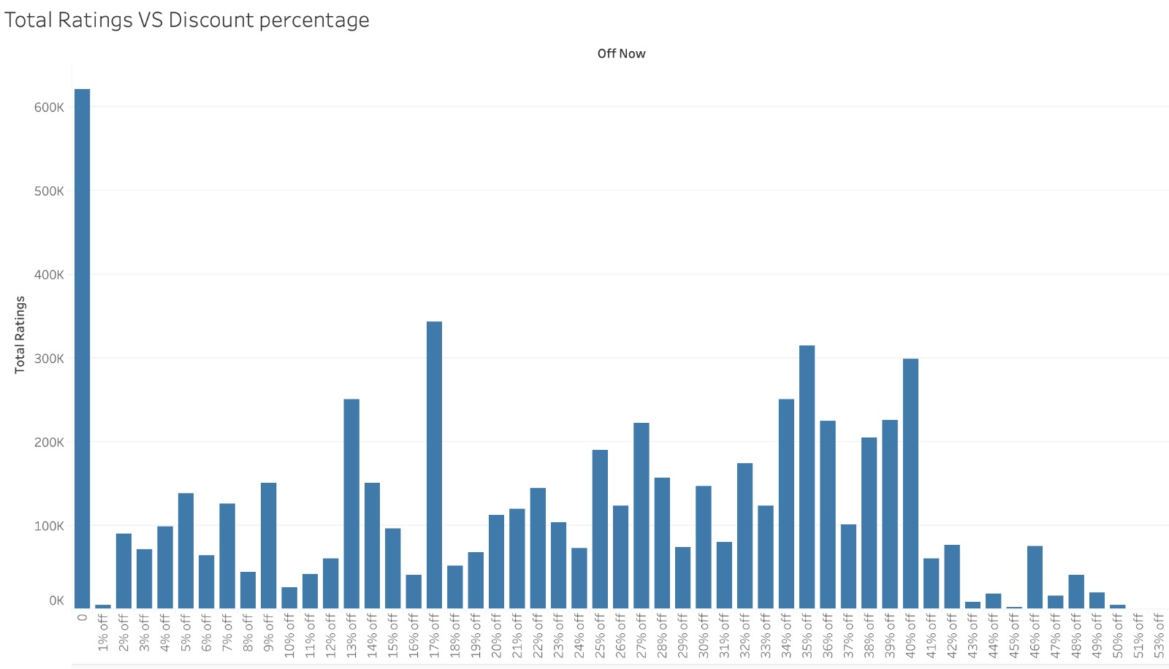
Visualizations
The chart shows that products without discounts receive the most ratings, while varied rating counts across discounted items suggest no clear trend between discount depth and customer engagement.

Slide 15
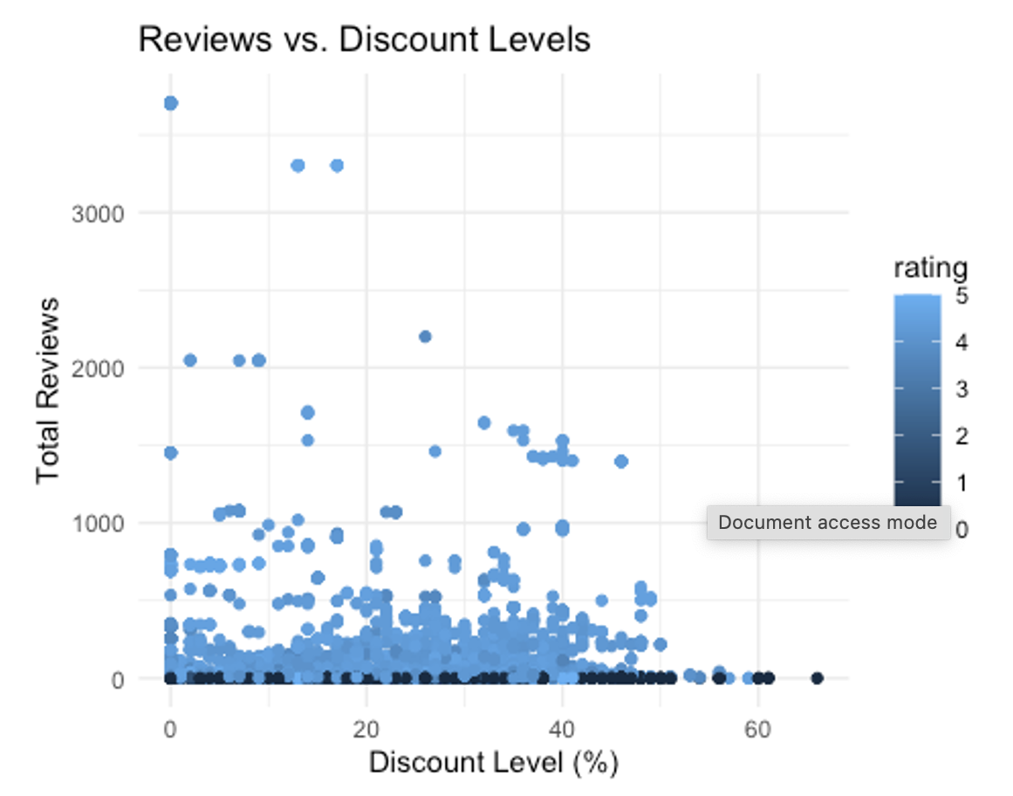
Visualizations
This plot illustrates the relationship between the number of total reviews and the discount level on laptops, with color indicating the rating. It helps to visualize if discounts correlate with the quantity of reviews and if higher or lower ratings are associated with certain discount levels.

Slide 16
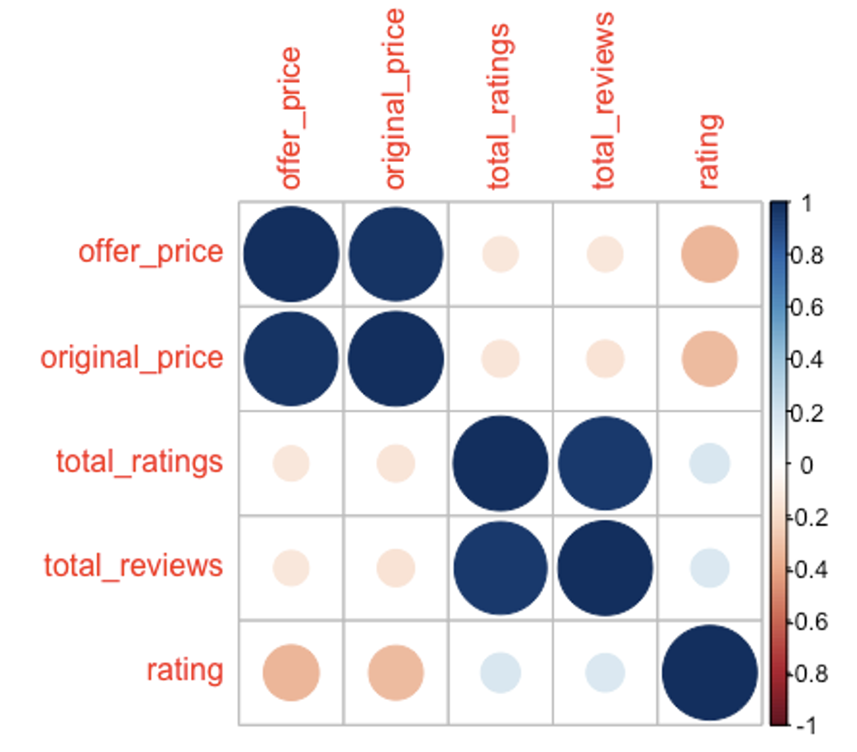
Visualizations
This heatmap shows the strength and direction of the relationship between different numerical variables like offer price, original price, total ratings, total reviews, and rating. The size and color of the circles represent the magnitude and direction of the correlation.

Slide 17
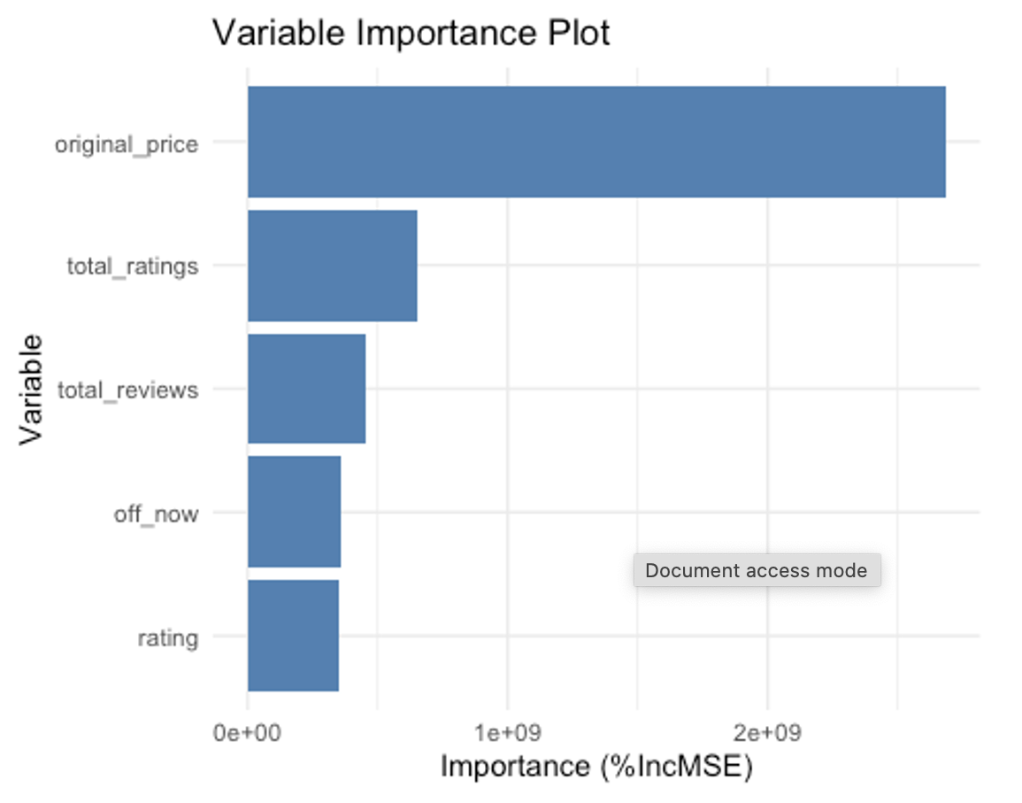
Visualizations
The bar chart indicates the importance of each variable used in the random forest model to predict the offer price of laptops. It shows that the original price is the most important predictor, followed by the total ratings and total reviews.

Slide 18
Solutions
Data Preparation and Cleaning: Initiated by meticulously compiling and cleansing the dataset to ensure data integrity and uniformity, which is crucial for accurate analysis. This includes handling missing data, correcting inconsistencies, and standardizing data formats.
Exploratory Data Analysis (EDA): Conducted descriptive statistical analysis and visualized data distributions to identify patterns, anomalies, and initial insights, laying the groundwork for deeper analysis.
Advanced Analytical Techniques: Utilized correlation analysis to explore relationships between variables and regression analysis to understand how factors such as discounts impact customer ratings and pricing. Employed machine learning algorithms like random forests and gradient boosting to model complex interactions and predict trends.
Visualization of Results: Created a range of visual tools, including heatmaps, scatter plots, and time series graphs, to vividly demonstrate findings and make the data accessible and understandable for stakeholders.

Slide 19
Results and Discussions
Our analysis indicates a significant correlation between product discounts and customer reviews, suggesting that strategic discounting could positively influence consumer engagement and feedback.
We observed that price points vary notably with customer ratings, indicating that ratings could be a pivotal factor in setting competitive prices and driving sales.
These insights inform that during sales events, pricing and promotions should be dynamically adjusted in response to consumer ratings and review trends to optimize sales performance and customer satisfaction.

Slide 20
Conclusions and future works
This project showcases the power of big data analytics in decoding complex retail interactions, leading to more informed decision-making and strategy development in the retail industry.
By identifying key price influencers and customer behavior, we have created a roadmap for optimizing sales events and enhancing customer satisfaction.
Future work should focus on integrating more data sources, such as social media sentiment and competitor pricing, to further enrich analysis and drive retail innovation.

Slide 21
Acknowledgement
We would like to express our sincere gratitude to Dr. Hadi Rezazad who conducted the classes for AIT 622 004 and guided us with helpful contents along with tools like Big Data, Cloud Computing, and so on. Without these, this research wouldn’t have been possible. Thank you for all insights and knowledge.
REFERENCES
[1] Flipkart - Electronic items prices. (2022, November 10). Kaggle. https://www.kaggle.com/datasets/kiranbudati/mobile-prices-flipkart/data
[2] Anderson, G. (2022, August 29). The 6 most important B2B eCommerce Stakeholders. Corevist. https://www.corevist.com/6-important-b2b-ecommerce-stakeholders/
[3] Agarwal, N. (2024, April 9). The build vs. buy guide for the modern data stack. Monte Carlo Data. https://www.montecarlodata.com/blog-the-build-vs-buy-guide-for-your-modern-data-stack/
[4] R Core Team. (2021). R: A language and environment for statistical computing. R Foundation for Statistical Computing, Vienna, Austria. URL: https://www.R-project.org/

